Slide 1
Landscaper
Homework Week 3

Slide 2
GOALS
GAME: Design a short game that utilizes arrays/objects/etc.
GOAL of Game: To make $1000 by working and acquiring tools with earnings.
UX: Focus the design of the game on the user experience.
Should be FUN
Should be INTUITIVE
Should be INTERESTING/CHALLENGING

Slide 3
Flow of Game
Start Game
User Enters Name
Work
Acquire Tools
Win/Lose Game

Slide 4
Requirements
The ability to take USER INPUT (we’ll use DOM/buttons/input forms/etc)
The ability for the user to EARN MONEY
There will eb a running total of EARNED MONEY
The various TOOLS GENERATE the MONEY
The ability to BUY TOOLS and USE the NEW TOOL
The totalEarnedMoney can be used to BUY TOOLS
The ability to WIN the GAME and END IT
User WINS game if they acquire X amount of money – Game State turns to appropriate level or WIN state.
User can END game at any point.
User LOSES game if _____ (optional).
Hint: Try setting the win amount to $10 first, then $50, and etc. until you get to the end to allow for easier testing!

Slide 5
Bonus Requirements
Hungry for More?
Add ability to RESET the game at any point
Users can have MULTIPLE TOOLS (e.g. 2 scissors AND a push mower)
Users can SELL tools for HALF price
Super duper hungry?
Make game playable via the DOM via BUTTONS / INPUT FORMS as opposed to using the console and alerts and prompts!

Slide 6
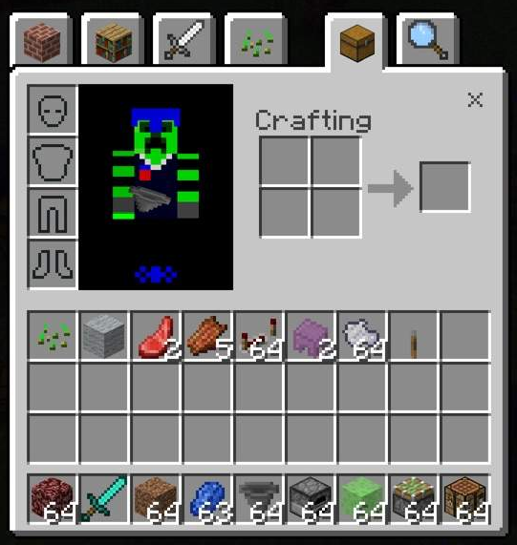
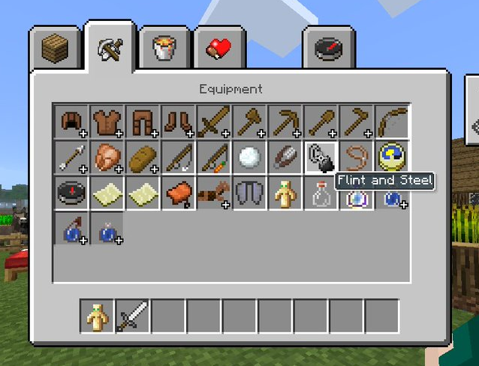
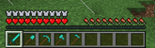

Slide 7
MINECRAFT Mockup
BUTTONS
NEW GAME
BUY
MOW
QUIT GAME
SELL
PLACES
Place to BUY NEW TOOLS
CURRENT TOOL /
INVENTORY
MONEY / TOTAL MONEY
Place for PEOPLE / NARRATOR to speak
BAR showing how much MONEY visually?
Maybe SLIDING PANELS?

Slide 8



HOME DEPOT
&
CONSTRUCTION GUY (only opens when enough money for first new tool)
LAWNS
&
CUSTOMER
CAR
(NEW GAME
or
QUIT)
MONEY
DIALOGUE
INVENTORY
$0

Slide 9
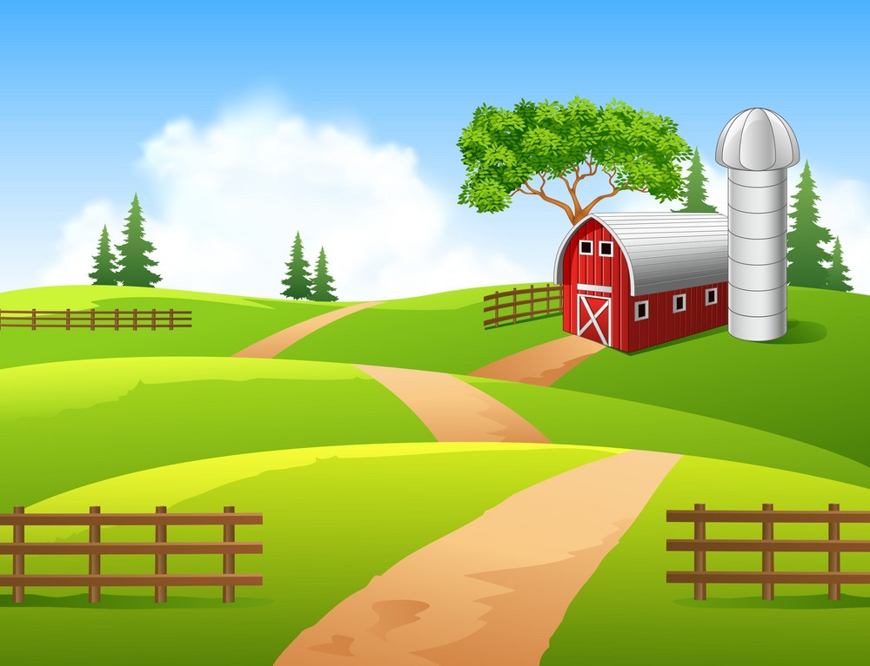

Slide 10

B E L T S

Slide 11


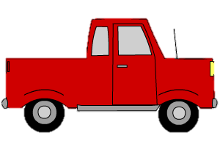


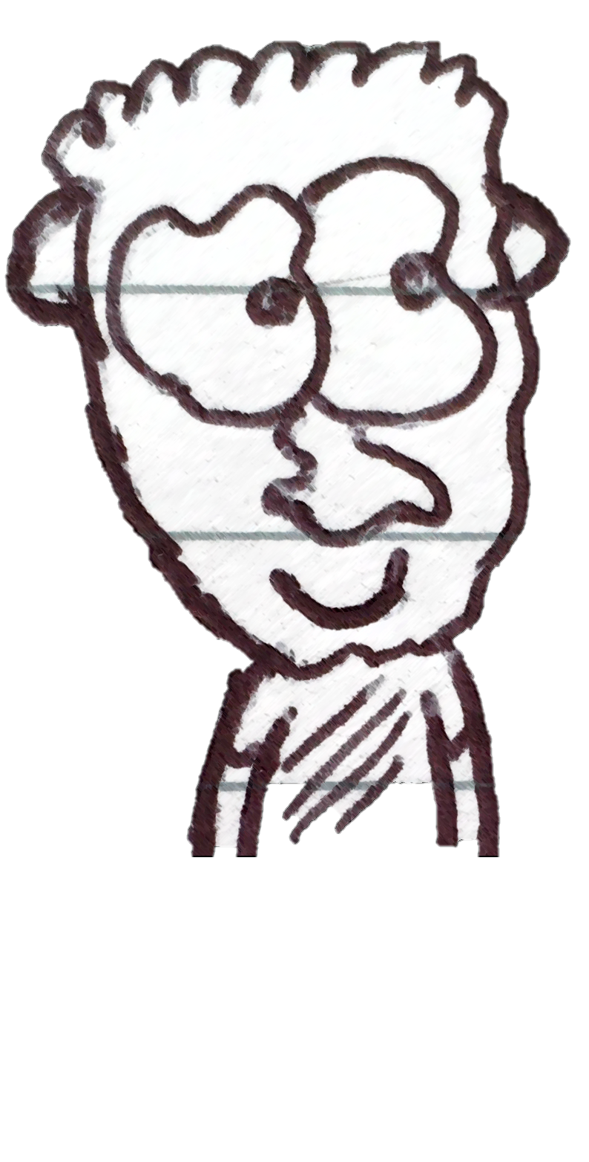
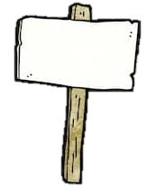

EXIT
B E L T S
B E L T S

Slide 12

